Slide 1

ROUTINE HEALTH INFORMATION SYSTEMS
A Curriculum on Basic Concepts and Practice
MODULE 2:
Indicators and Data Collection and Reporting
SESSION 2:
Data Collection and
Reporting Tools
The complete RHIS curriculum is available here:
https://www.measureevaluation.org/our-work/ routine-health-information-systems/rhis-curriculum

Slide 2
Learning Objectives
Participants will be able to:
Understand how data-collection is linked to the identified indicators
Define key data-collection concepts (data and data elements/information/knowledge)
Describe sources of RHIS data
Identify data collection tools for RHIS data
Identify methods of collecting routine health information
Select the correct data source and data collection tools for obtaining needed RHIS data to manage a health program
Explain gender-sensitive data, sex- and age-disaggregated data, and links with data collection tools
Notes:
Goal of the session: By the end of this session, participants should be able to identify sources of RHIS data needed for the indicators selected and also data collection tools used to obtain these data, which are needed for managing health interventions and programs.

Slide 3
Basic Concepts
Data Element and Data
Information
Knowledge
A “data element” is a recorded event. “Data” represent an aggregation of data elements, in the form of numbers, characters, and images.
Data are organized with reference to a context, which gives data meaning.
When information is analyzed, communicated, and acted upon, it becomes knowledge.
Notes:
Raw data are available at the first stage of information gathering and are not directly useable by all players. For them to be useable, they must be transformed into information that can be used to answer a question of interest.
Example: The outpatient register captures a list of patients with their symptoms, their diagnoses, and the treatments they have received. These data are useful to the care provider, but if the health facility in-charge wants to know the volume of work done in the outpatient department, he/she needs to transform the data into a meaningful summarized measurement, such as the number of patients seen in the outpatient department in a given period.

Slide 4
DATA COLLECTION
Notes:
Data collection begins at the time of interaction between health providers and client or patient. This process of gathering information is used first for patient management and then for health unit management and ultimately to improve the overall health system.

Slide 5
Discussion
Why Do We Collect RHIS Data?
Classify answers according to
Management level (community, patient, facility, system)
Health-system building block (service delivery, resource mobilization, financing, stewardship)
Health determinant (healthcare, lifestyle, environment)
Notes:
Management level:
Client management/individual care includes but is not limited to delivery of promotional, preventive, and curative health services to the
population; working with communities)
2. Health unit/facility management refers to managing service coverage/utilization, resources, etc.
Health system management stresses mostly coordinating and managing support to health units.
Health system level:
• Planning, management, and M&E of health services
• Regulation and stewardship: setting policies
• Public health interventions, including in other sectors

Slide 6
RHIS Data Are Needed to….
RHIS data are collected for the information needs and indicators that were identified to:
  Understand the health status of the population
  Enhance health system performance through evidence-informed decision making for all major building blocks
    Service delivery
    Resource mobilization
    Financing
    Stewardship
  RHIS data are needed from the community all the way up to the national level for planning, management, and monitoring

Slide 7
Data Collection
Types of Data to Be Collected:
      Patient/client data
      Health facility data
      District level data
Data Collection Tools and Forms
      Patient and client data forms (individual records such as immunization cards)
      Health facility data forms (tick register, registry and tally sheets)
      Community data forms (register, tally sheets)

Slide 8
Group Exercise (Handout 2.2.1)
Read the Case Study and Answer the Questions
Why do we collect RHIS data?
What RHIS data do we collect?
How do we collect RHIS data (methods and tools)?
Who collects RHIS data?
30 minutes for discussion in small groups
30 minutes for plenary discussion
Notes:
Tell the participants: “Data collection is a fundamental component of a RHIS processes. After needed or required indicators or data elements have been identified, data should be collected to calculate the indicators or to report on the data elements. We want you to review the case study of Country A and tell us the process of data collection, drawing from your wealth of experience in managing RHIS. Everyone is going to be a facilitator for this session.”
1. Divide the participants into at most 5 groups (depending on the number of participants). Each group should not have more than 5 or 6 people.
2. Distribute the case study on data collection.
3. Each group should elect a leader and note-taker.
4. Each group should read the case study and answer the 4 questions.
5. In plenary, each group will choose a question and present its answer. Then the other groups will add details they think are missing.

Slide 9
Health Information System: Data Sources
(HMN, 2008)
Census
Resource
records systems
Vital
registration
Services records systems
Pop based
surveys
Individual
Records systems
Population-based
data sources
Facility- and community-based
information systems--also called
routine health information
systems (RHIS)
Notes:
HIS can be subdivided in population-based data sources and facility and community-based data sources (HMN, 2008).
Another way to categorize health information system (HIS) subsystems is based on the frequency of data collection.
Routine data collection refers to data that are collected continuously, with processing and reporting more often than annually. Routine health information systems (RHIS) are facility-based and community-based subsystems that collect routine information on patients as they use services. Vital registration is routine data collection on vital events (births, deaths, and migration data) and occurs mostly outside the health system.
Nonroutine data collection refers to data that are collected on a periodic basis. The periodicity is usually less frequent than annually. Examples of nonroutine data sources are household surveys and a national census. Research might also be a data source; the experimental design may require continuous data collection with the findings reported at the end, or perhaps following a mid-experiment review of the data.
This course focuses on RHIS data.

Slide 10
RHIS Focuses on facility and Community Health Information Systems
  RHIS can be structured in the following “subsystems”
  Individual records systems (facility-based as well as community-based)
  Service record systems (facility-based as well as community-based)
  Resources records systems (human resources, health commodities, financial resources, infrastructure
  Health status data ((facility-based as well as community-based)
  Sentinel reporting/demographic surveillance

Slide 11
Data Collection Tools and Forms Used for
RHIS Data Collection
Patient or client data collection tools (individual records)
  Individual patient or client records (including electronic records)
  Prescription cards, patient files, immunization cards
  Preventive record cards
  In-patient record cards
Health service and resource data collection tools
  Tick registers
  Tally sheets
  Registers
Notes:
Specialized data collection tools
Supply chain management: Bin cards/stock file; ledgers
Financial resources: Ledger; cash book; voucher

Slide 12
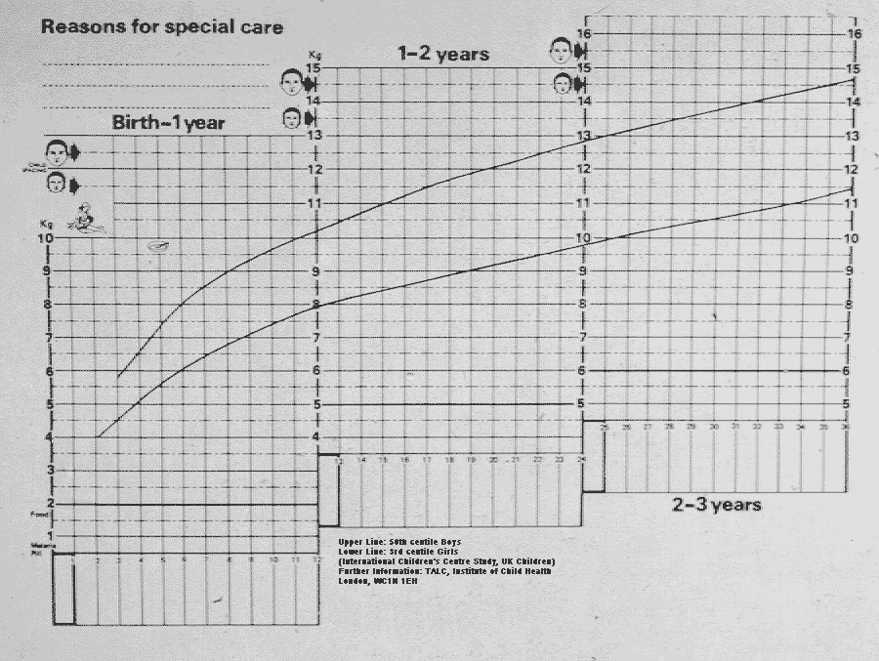
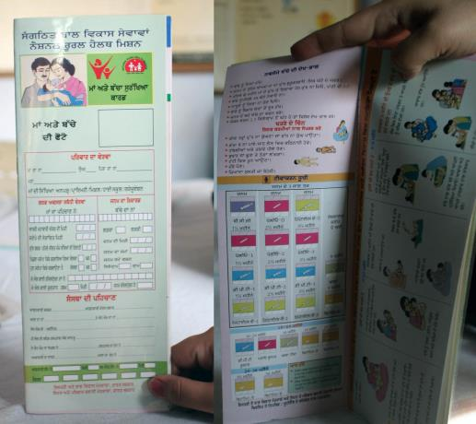
Patient/Client Record Cards
Notes:
12
Examples of ways to record details of the client’s interaction with the health service:
Health facility-held record system (traditional): carries the risks of misfiling and loss
Client-held record system (such as the Road to Health Card, Child Health Booklet, Women’s Health Book, a TB patient treatment card): associated with efficiency; suitable for a mobile population

Slide 13
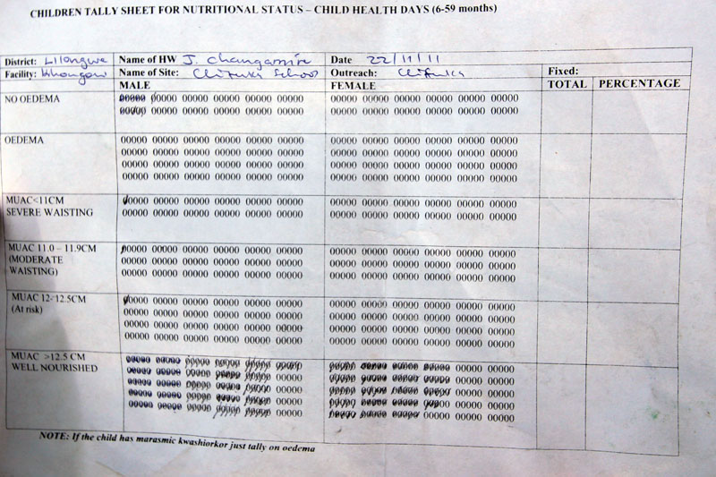
Tally Sheets
Used to count identical events that do not require follow-up
Example of a tally sheet for head counts of the number of children weighed:
Notes:
Discuss the content and common data elements usually collected using a tally sheet.

Slide 14
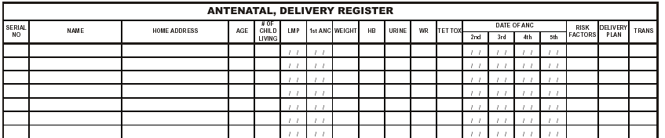
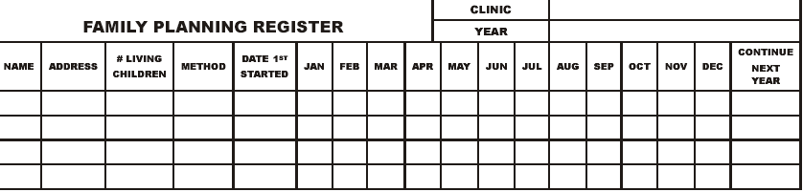
Registers
Used to record data that need follow-up over long periods, such as antenatal care (ANC), immunization, family planning, and tuberculosis (TB)
Notes:
Discuss the content and common data elements usually collected using a register.

Slide 15
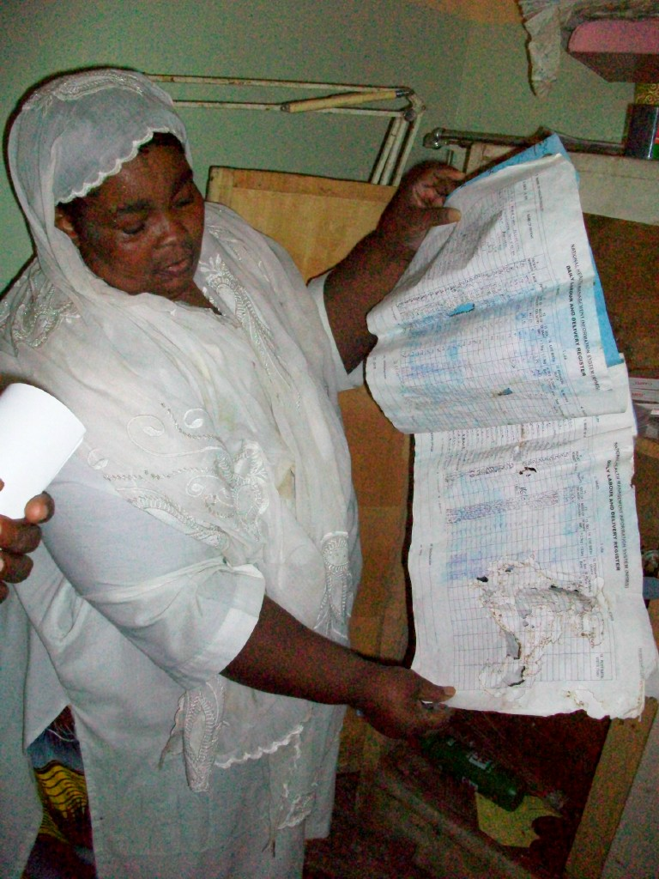

  Key Data Elements from These Sources:
  Registers
  Patient cards
  Tally sheets
  Logbooks
Notes:
Discuss key data elements collected in registers, patient cards, tally sheets, and logbooks.
Give the participants Handout 2.2.2, which is a sample of data collection tools: individual cards and registers.

Slide 16
Data Collection: At the Point of Care
Facility service data are collected by nurses and doctors between sessions with patients
  Community service data: by village health workers, traditional birth attendants, and community- based distributors
Usually several (manual) steps before data are in any database/storage
  Tally sheets
  Tally sheet totals at end of month
  Monthly summary forms, which are reported to the next level
Often, there is too much data to collect by already overworked staff

Slide 17
Paper-Based Records Versus Electronic Medical Records
An electronic medical record platform requires less staff and time and no physical storage space.
It entails initial costs as it is being implemented.
However, the costs of records over time will decrease significantly.
Paper records require additional staff to handle and support paper files and to organize countless documents.
They are less costly at first but highly vulnerable to break-in.

Slide 18
Paper-Based Records Versus Electronic
Medical Records
Because everyone’s handwriting is different, paper records are sometimes illegible.
Space to write everything down is limited.
Additional staff are needed to handle and support paper files and to organize countless documents.
Electronic medical records have enough space to write what is needed to document a patient encounter.
With electronic medical records, medical professionals have access to the data they need instantly.

Slide 19
Data Aggregation and Reporting
DATA AGGREGATION
AND REPORTING

Slide 20
Data Aggregation and Reporting
Gathered and expressed in a summary form
Where data are searched, gathered, and presented in a report-based, summarized format
Data aggregation may be performed manually or electronically (using software)
Notes:
Data aggregation is a process in which individual data from clinical records or cumulative data from registers or tally sheets are gathered and summarized.
Data aggregation may be performed manually or using specialized software.

Slide 21
Purpose of Data Collection and Reporting
    Obtain information about health conditions and characteristics
    Report information manually or electronically to higher levels: from facility to district (or other local government authority), from district to region (or state), and from region to national government authority
    Inform periodic self-evaluation (for example, to monitor facility-based coverage rates)

Slide 22
Data Aggregation and Reporting: Tools
Summary in tabular form
Graph
Dashboard
Information board at community level
Notes:
Aggregated data are usually presented in different formats such as. . . [Read the slide.]

Slide 23
Data Aggregation and Reporting: Types
Routine reporting
Health unit notifiable disease report
Weekly epidemiological surveillance report
Health unit outpatient monthly report
Health unit inpatient monthly report
Health unit performance
Health unit quarterly report
Health unit quarterly assessment report
Health unit annual report

Slide 24
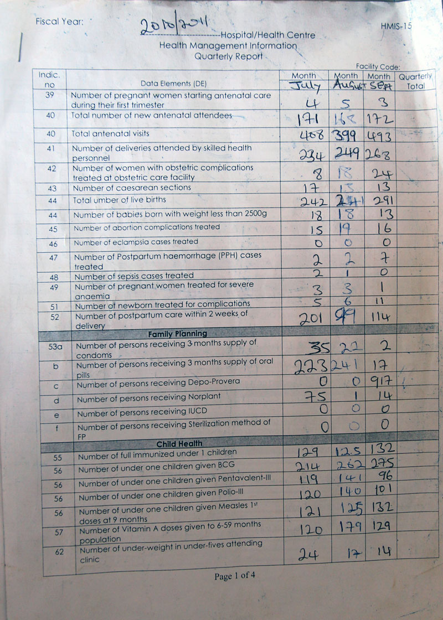
Data Reporting: Frequency
Reports can be:
Weekly
Monthly
Quarterly
Semiannual
Annual
Notes:
Aggregation can be done using individual data from clinical records or cumulative data from registers or tally sheets.
Aggregation is a periodic process. It can be designed so that indicators can be calculated, but this is not its main function.
The periodic report may be:
• Weekly, for potentially epidemic diseases
• Monthly, for medical health activities
• Quarterly, for the follow-up of tuberculosis patients
• Semiannual, for monitoring
• Annual, for summaries

Slide 25
Data Reporting: Weekly Cholera Cases Reported in a Health Facility

Slide 26
Data Reporting:
Monthly Antenatal Consultation Report

Slide 27
Data Reporting:
Annual Summary of Outpatient Consultations
Notes:
The annual report presents indicators or data elements over a 12-month period. Using this report, program managers and policymakers as well as other stakeholders may identify seasonal variations, patterns, or events and problems encountered, in order to highlight trends and better predict the following year’s activities.

Slide 28
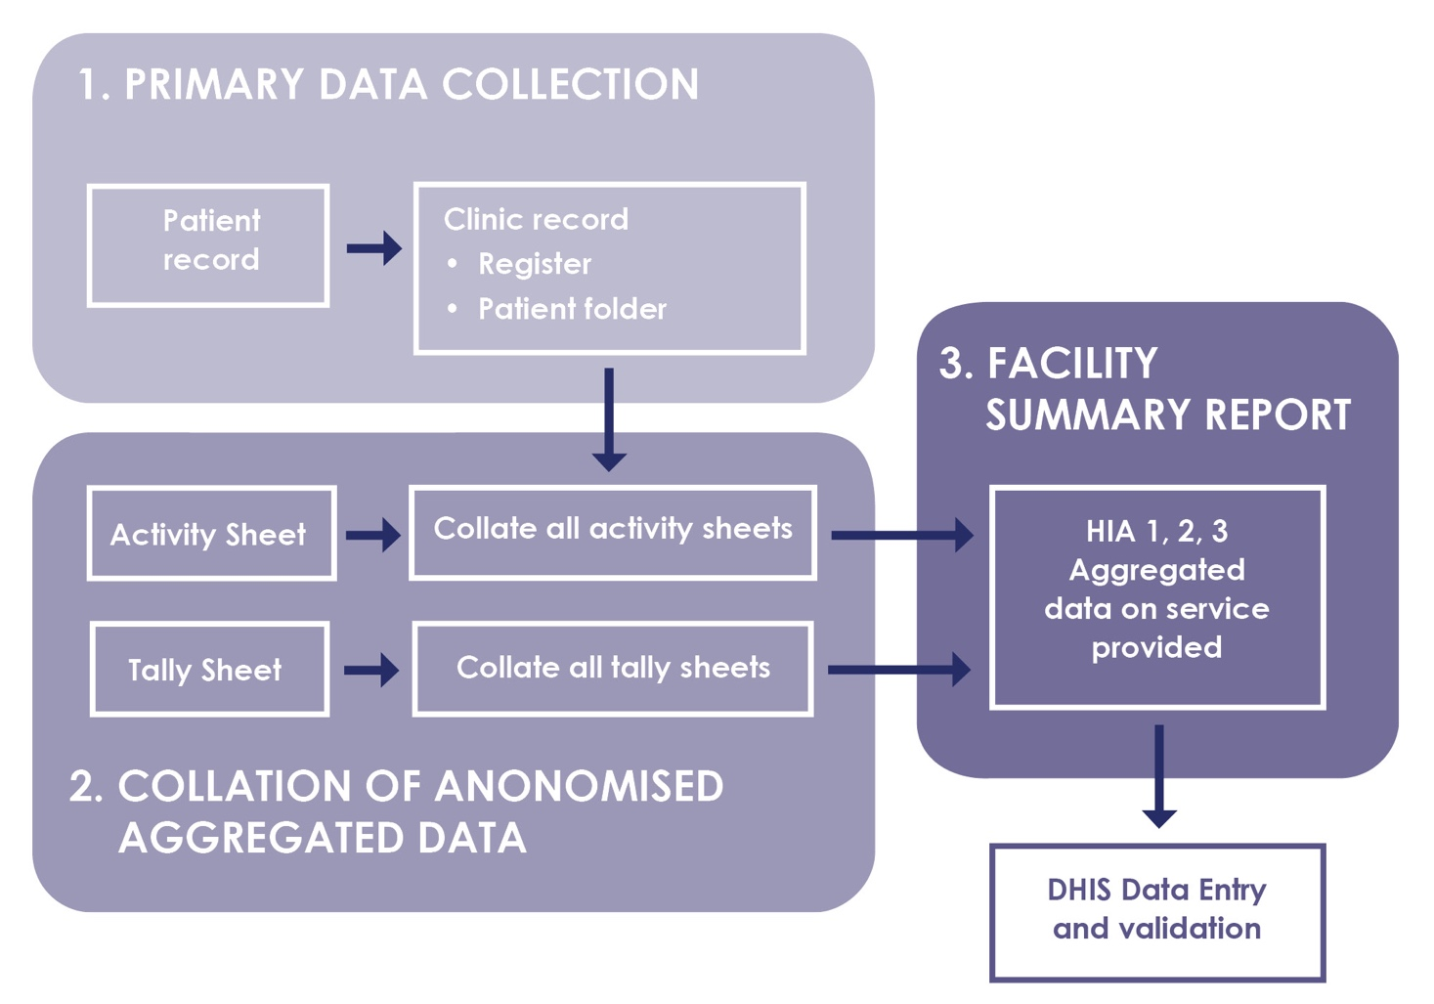
Example of Data Collection, Collation, and Reporting in a Health Facility (Zambia HMIS Procedure Manual)
Validate between registers and activity sheets
Patient record, activity sheet or tally sheet updated at the same time

Slide 29
Specific Topics around RHIS Data Collection and Reporting Tools/Forms
  Types
  Content (comprehensive)
  Record filing (patient-retained vs. health unit-retained)
Notes:
Types:
At the patient/client management level, medical records are data related to the management of health status of an individual patient. These collection forms for patient/client management can be anything from a simple piece of paper to a fancy colored plasticized card, a health booklet, or an electronic file.
At the health-unit management level, data are collected to permit health unit staff to make operational decisions (service-delivery management decisions and resources management decisions).
Content refers to what should be recorded on data collection instruments for patient/client management. It highly depends on the information the care provider needs in order to make appropriate decisions. It serves as a memory aid to the care provider if the patient returns.
Record filling often opposes patient-retained versus health-unit retained forms. There are always pros and cons, and perhaps the best solution is a combination of both systems.
For efficient patient/client follow-up, the tickler file system is particularly well-suited. It consists of two file holders which can accommodate the size of the record forms. One box (the “days box”) is divided into 31 slots; the other box (the “months box”) is divided into 12 slots. After each patient’s visit, the patient’s files are moved to the appropriate boxes. At the end of the day, remaining records in the days box are missed appointments.

Slide 30
Issues with RHIS Data Collection and Reporting Tools/Forms
  Layout (self-explanatory)
  Production form
  Electronic patient record
Notes:
Layout refers to the following: enough space for recording; logical order of data element to guide the healthcare providers; preprinted checklist to reduce the time needed to fill the data collection and make them more legible and quicker to aggregate; multicolored record forms. which are attractive but expensive. Keep in mind that the layout can have a major impact on the accuracy of data.
Production: For patient/client management, the record forms for acute curative care can be made out of cheap paper while the patient retained follow-up record cards should be made out of cardboard or plasticized paper.
At the health-unit management level, the most common form of service record is a register in which clients are recorded by name, along with such information as date of visit, diagnosis, nutritional status, and so on.
Electronic patient record: This is considered the best approximation available of an ideal patient record form. Keep in mind, in most places there is a lack of trained staff and hardware and software capacity maintenance at the health-unit level.

Slide 31
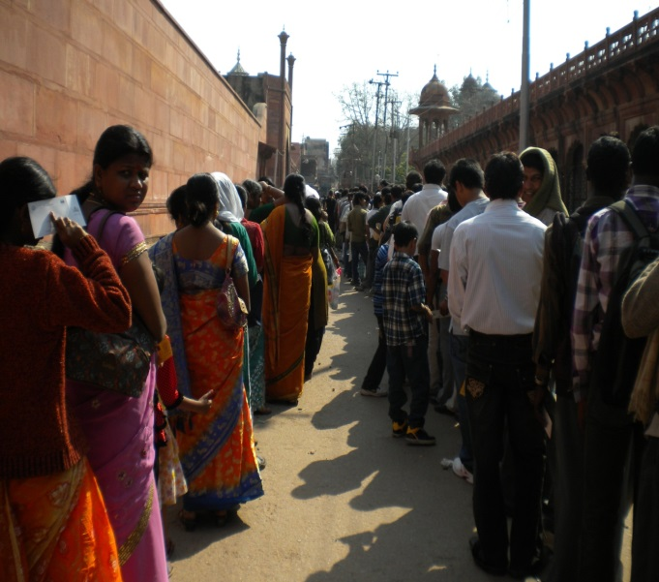
Data Collection and Reporting: Gender Sensitivity
Health conditions differ by gender and age.
Design the data collection and reporting tools to:
Collect and report data on females and males
Capture gender-sensitive indicators
Capture gender-sensitive health outcomes
Notes:
To ensure that distinct impacts of health programs are captured for girls, boys, women, and men, data collection tools should be designed to allow disaggregation by sex and age.
When looking at monitoring from a gender perspective, we want to ask, “Are programs adequately addressing gender?”
Gender monitoring looks similar to typical monitoring but has additional questions to help measure differences in how men and women and boys and girls benefit from a program.
At the most basic level, gender monitoring requires sex-stratified analyses of routine data, so that differences between women and men (or girls and boys) can be examined in program implementation and health outcomes.
Gender monitoring should ideally also use gender-sensitive indicators. These are indicators that go beyond sex disaggregation (but are still to be collected by male/female, as applicable) to directly measure aspects of gender and more thoroughly examine how gender relations affect development outcomes.
In any efforts to monitor programs or policies, it is important to analyze by sex, and when possible, use gender-sensitive indicators that specifically look at gender and health. Thus, it is crucial to collect data with sex and age as part of the data elements.

Slide 32
Data Collection
Golden Rules
Keep data collection instruments (DCI) as simple as possible.
Involve users in the design.
Standardize definitions and procedures and include them in a user’s manual.
Include appropriate facilitation for data use on your DCI.
Train care providers as data collectors and data users.

Slide 33
Group Exercise (Handouts 2.2.4a, 2.2.4b,
and 2.2.4c)
Read the Case Study and Answer the Questions
Handout 2.2.4a: Linking Indicators to Data Collection Instruments
Participants will be given the HMIS Indicator List (Handout 2.2.4b) and the HMIS Procedures Manual of Ethiopia (Handout 2.2.4c).
Study both documents and give your opinion on the strengths and weaknesses of their content and format.
For the following indicators, identify the data collection and reporting instruments as listed in the HMIS Procedures Manual:
  C1.1.1.7 Early postnatal care coverage
  C1.1.3.1 DPT1-HepB1-Hib1 immunization coverage
  C1.4.2.2.7 Lost to follow-up rate among all forms of TB cases
  P1.4 Average length of stay

Slide 34
Data Flow
DATA FLOW

Slide 35
Data Flow
“Data flow”: the process of moving data from the point where they are collected to the point where they are processed and used
Data flow tracks the steps in the data management process
Can be described visually by means of a data flow diagram
Notes:
The first step in understanding data management is to understand how data get from the collection point to the point where they can be used by a program. This process is known as “data flow.”

Slide 36
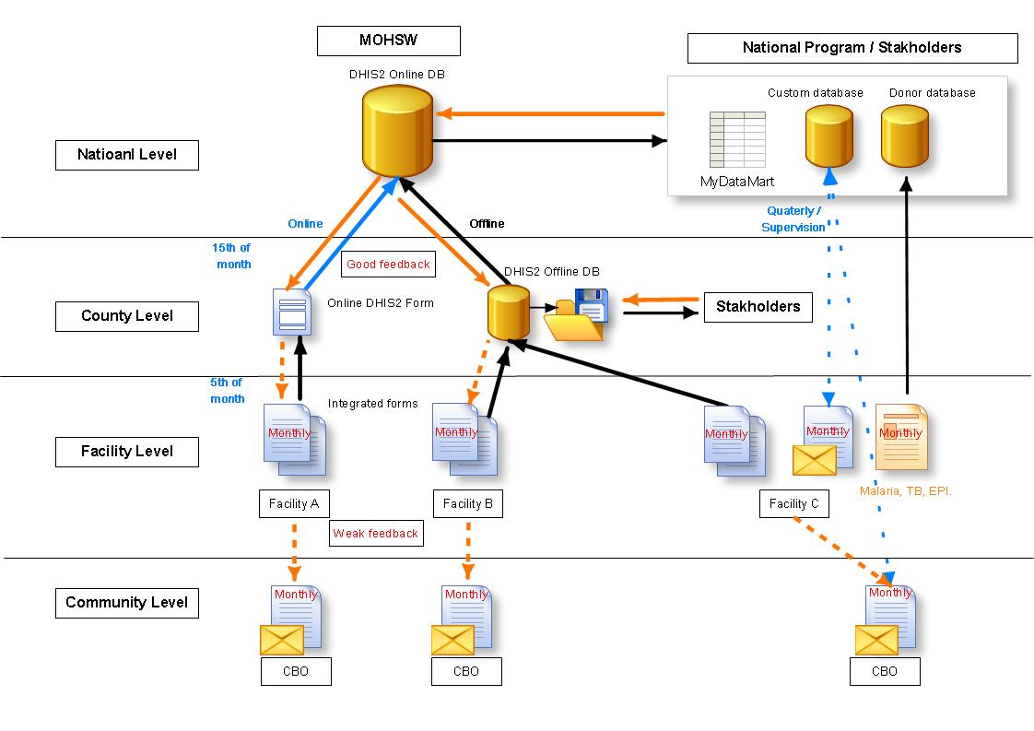
Example of Data Flow
National Program / Stakeholders
National Level
Stakeholders

Slide 37
Class Exercise (Handout 2.2.5):
Constructing a Data Flow Diagram
1 hour
Graphically map the data collection and reporting system for Country X.
Assume that the country’s health service delivery follows the facility, district, region, and national levels.
Please consider the following issues:
    Who will be responsible for data collection or completing each tool?
    Who will be responsible for supervising data collection?
    Who will be responsible for ensuring data quality at each stage?
    How is data quality checked at every stage?
    How often are the data collected, compiled, sent?
    What tools/forms are used, if any?
    How will data storage be handled?
    How will confidentiality of data be maintained?
    How will feedback related to data collection and reporting be handled?

Slide 38
Data Flow Exercise:
Discussion and Plenary
Review the data flow from each group.
Highlight key issues relating to data management, mentioned or not mentioned
The data flow should show
  What data are to be reported at each level of health information?
  Storage at intermediate level
  Data aggregation
  Transmission
  Data quality assessment
  Submission and archiving
Parallel reporting to program or nongovernmental organizations/implementing partners
Ideal RHIS is a unified system

Slide 39
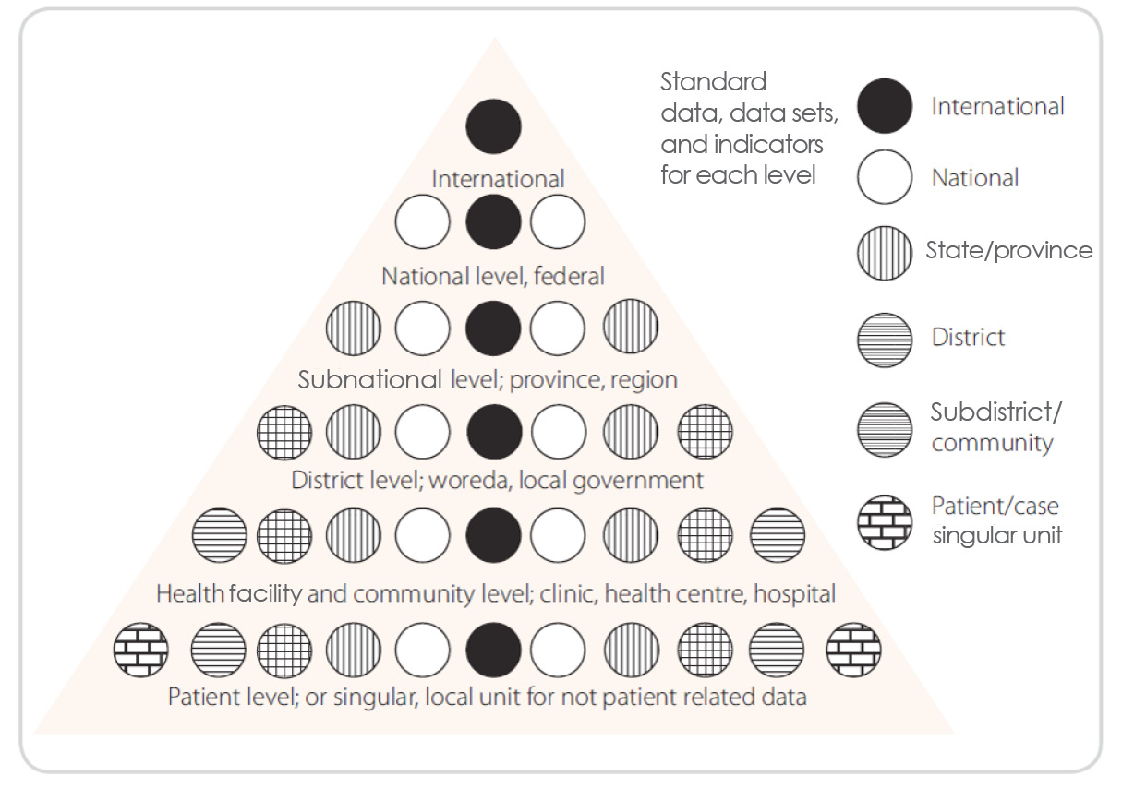
Indicator/Data Sets Pyramid
Hierarchy of standards
Notes:
As data flow from lower to higher levels, fewer data are required. Data collection normally begins at the community/facility level. The data should then be sent to the district office. From there, they may go to a regional office and then to a provincial level before being sent to a national office. Each level has different reporting needs and requirements. For example, the national level will have international reporting requirements. Thus, a health facility might want to know how many swabs are used on a daily basis, but this information would be irrelevant at the national level. In contrast, information such as the infant mortality rate is of international concern and thus important for all levels of the health system.

Slide 40
Challenges in RHIS Data Collection and Reporting
Group exercise (Activity 4): 45 minutes
Divide participants into small groups.
Ask them to generate a list of key challenges of RHIS data collection and reporting.
For each identified challenge, ask them to propose how to overcome it.
Report back to the big group.
Summarize.

Slide 41
Challenges in RHIS Data Collection and Reporting
(Possible Solutions to Address These Challenges)
Complexity of data collection and reporting tools
→ Simplification of the data collection
and reporting tools
Too much data to collect and report on
→ Refine the information needs based on functional analysis
Lack of supplies (frequent stockouts of tools)
→ Secure funding for standard tools provision
Notes:
Facilitator:
Indicate to the participants that these challenges of RHIS data collection and reporting can be organized according to technical, organizational, and behavioral factors. Later opportunities will be given to them to come back to these categories in Modules 9 and 10.

Slide 42
Challenges in RHIS Data Collection and Reporting
(Possible Solutions to Address These Challenges)
Lack of written data collection and reporting guidelines
→ Development of written guidelines (data management and procedures manual)
Existence of multiple data collection and reporting forms for the same staff
→ Data integration and interoperability (see
Modules 3 and 8)

Slide 43
Challenges in RHIS Data Collection and Reporting
(Possible Solutions to Address These Challenges)
Difference in reporting frequencies and deadlines
→ Harmonization of frequencies and reporting deadlines
Lack of staff competency
→ Organize training and supervision
Lack of motivation and reward system
→ Introduce a motivation mechanism

Slide 44
Data Collection and Reporting: Summary
Keep the system simple to operate and maintain.
Data processing and analysis begin at the point of collection.
Data for decision making: collection of only essential health data used for decision making
Data collection for local analysis and use by the health worker: data collected by all health workers as they perform their day-to-day duties

Slide 45
Q&A
Q&A

Slide 46
ROUTINE HEALTH INFORMATION SYSTEMS
A Curriculum on Basic Concepts and Practice
This presentation was produced with the support of the United States Agency for International Development (USAID) under the terms of MEASURE Evaluation cooperative agreement AID-OAA-L-14-00004. MEASURE Evaluation is implemented by the Carolina Population Center, University of North Carolina at Chapel Hill in partnership with ICF International; John Snow, Inc.; Management Sciences for Health; Palladium; and Tulane University. The views expressed in this presentation do not necessarily reflect the views of USAID or the United States government.

